Slide 1



C lor
Ed
Ed
C lor
Ed
Notes:
Various Logos

Slide 2


Notes:
Screenshot 1

Slide 3

Notes:
846x468 Promotional Image 1

Slide 4

Notes:
558X756 Promotional Image 2

Slide 5

Notes:
414x468 Promotional Image 3

Slide 6

Notes:
414x468 Promotional Image 3

Slide 7
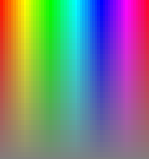
Notes:
Unused images and/or resources from here on

Slide 8


Slide 9


Slide 10


